Slide 1
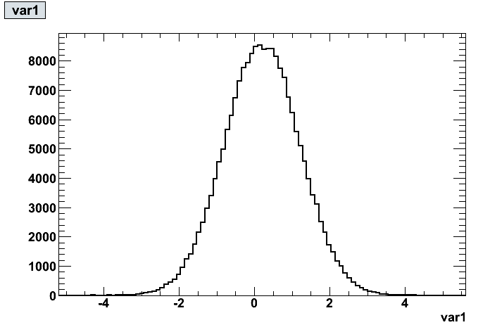
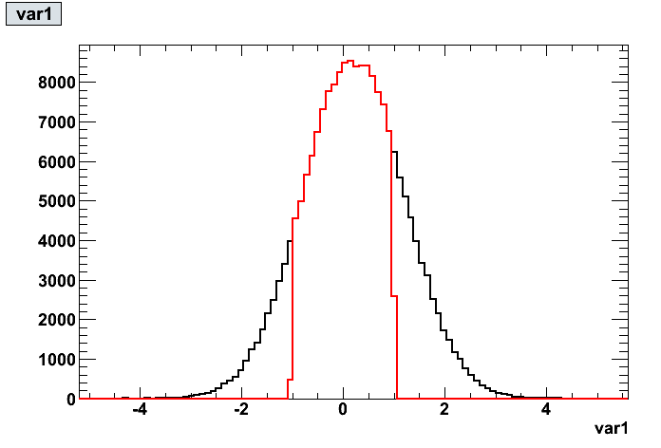
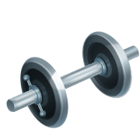
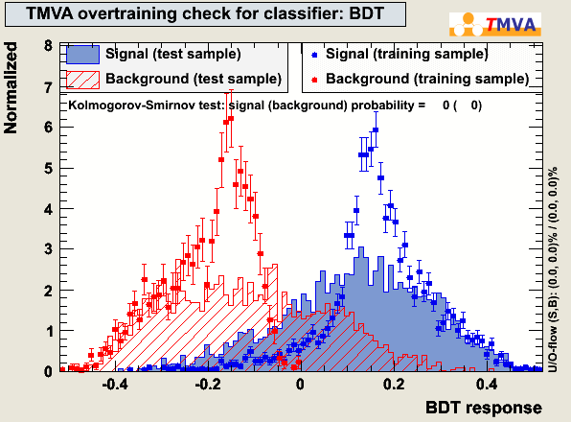
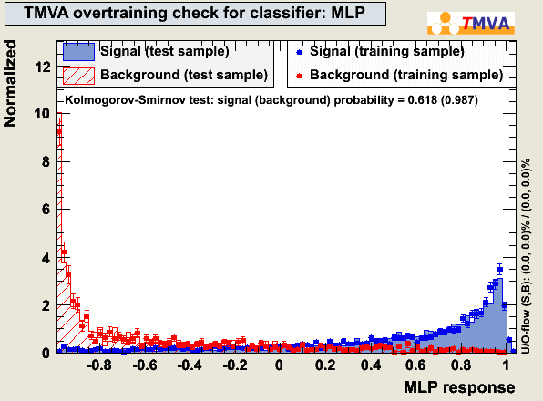
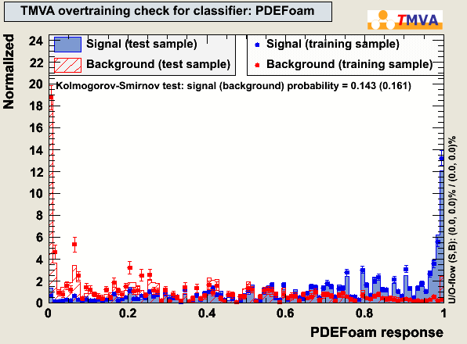
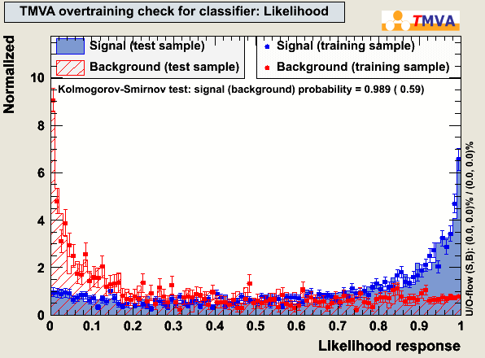
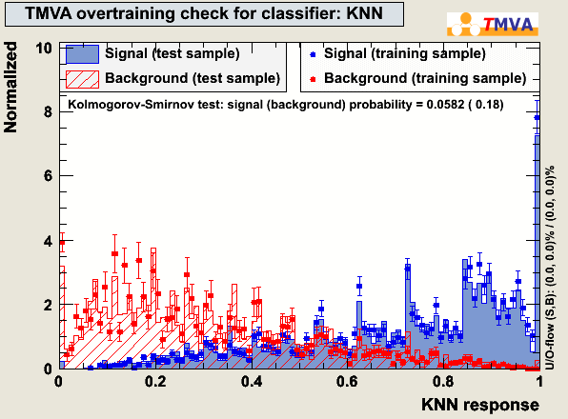
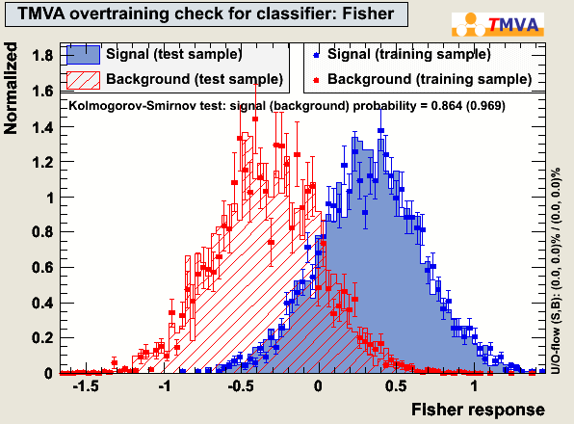
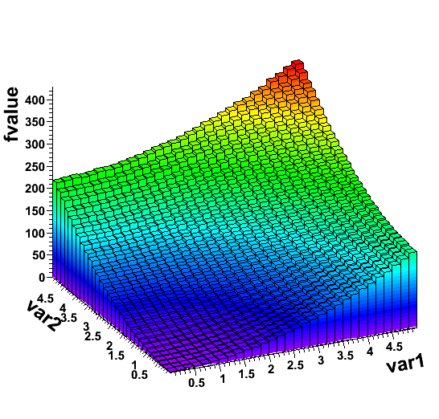
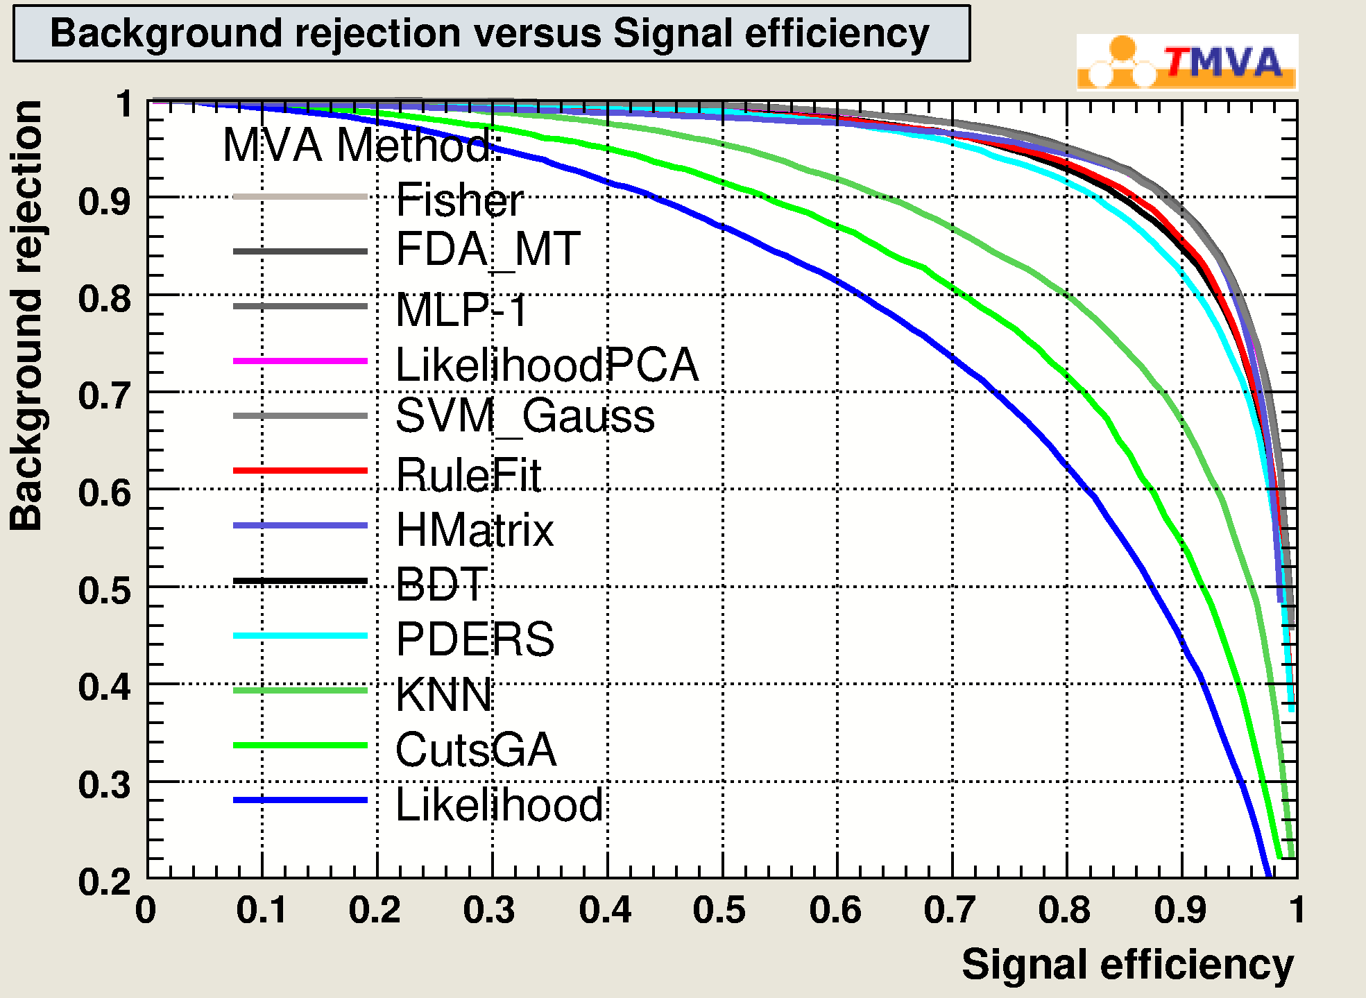
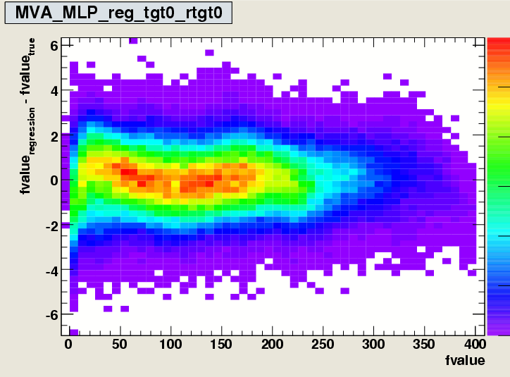
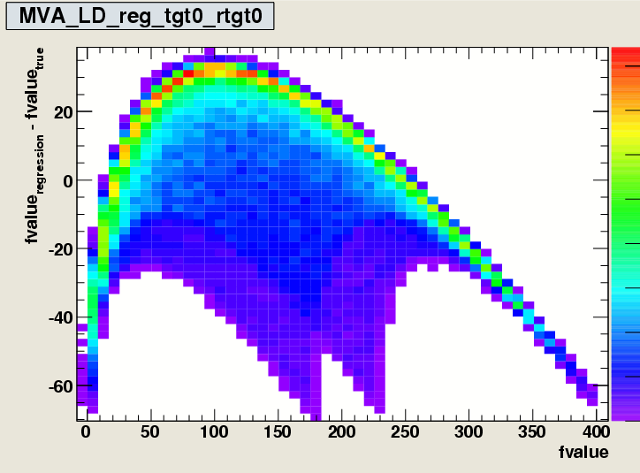
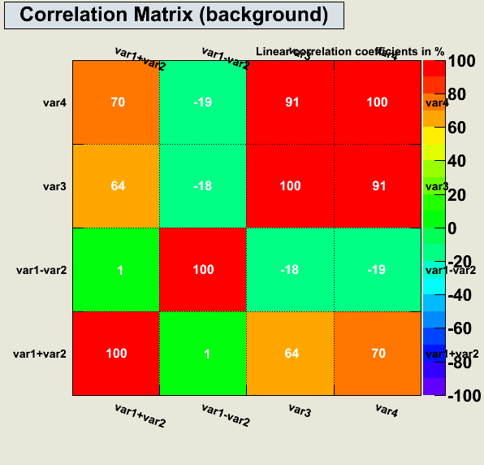
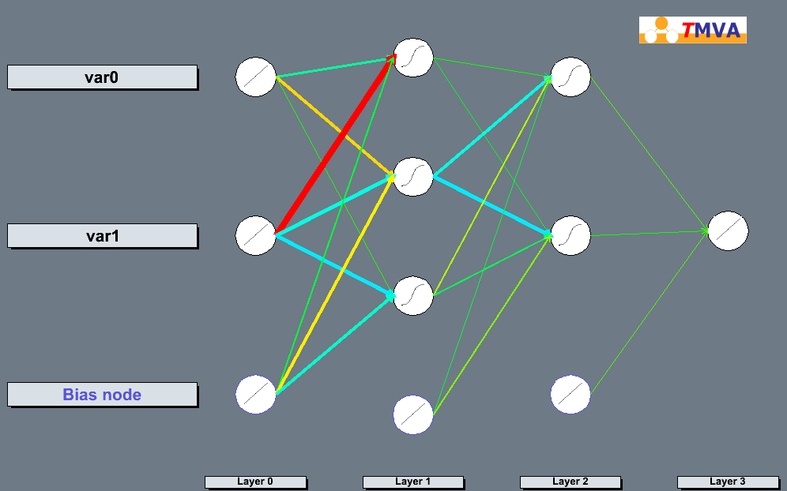
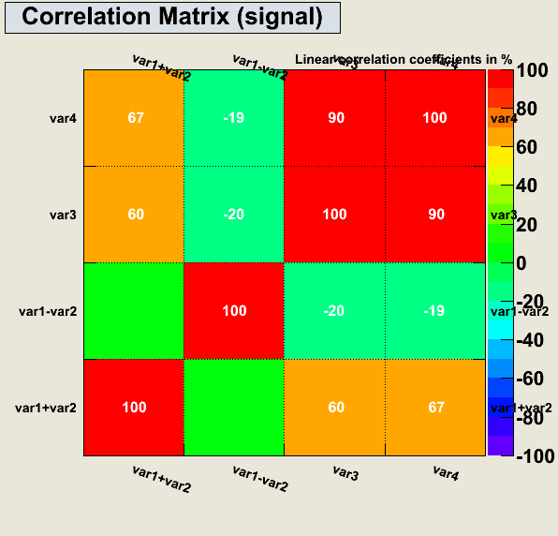
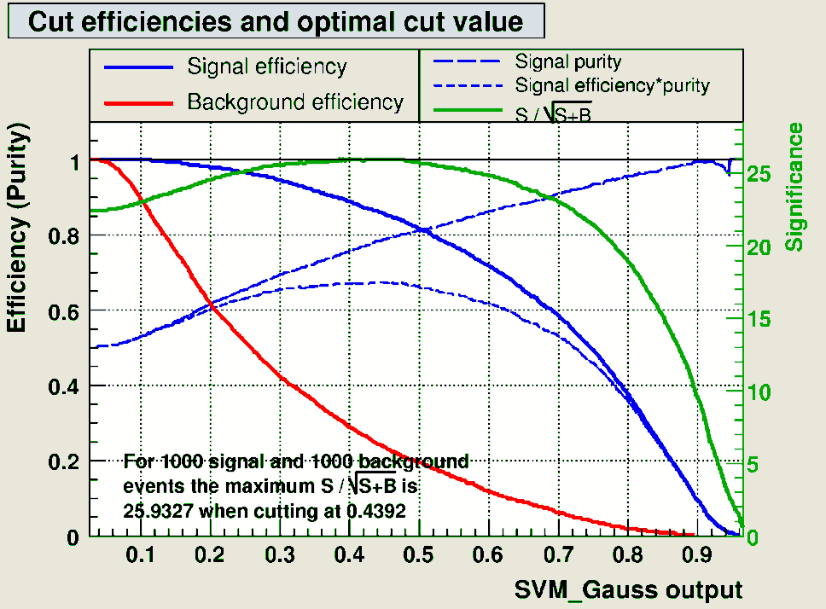
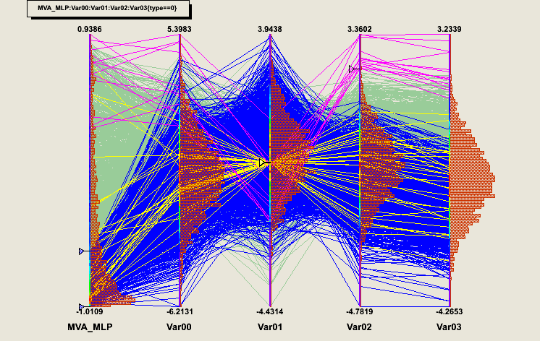
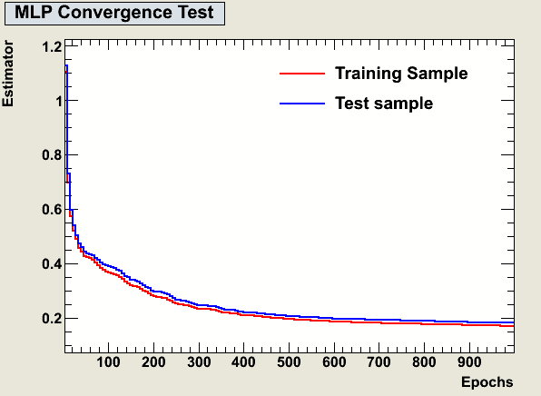
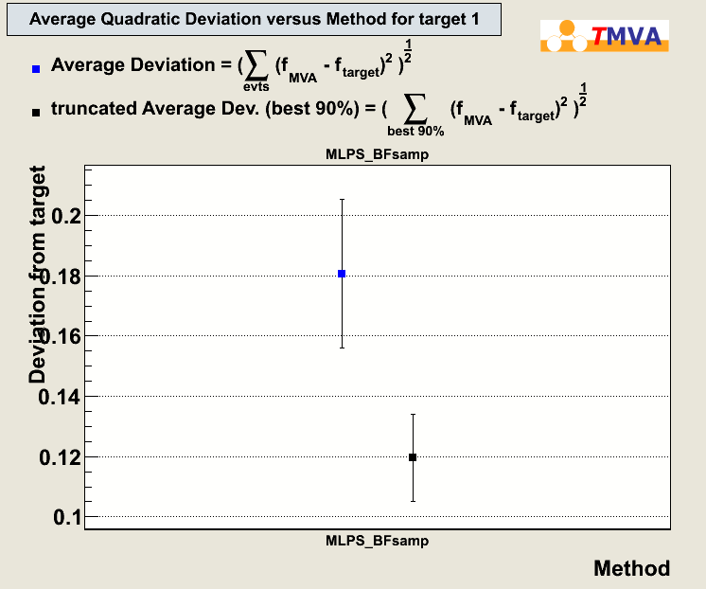
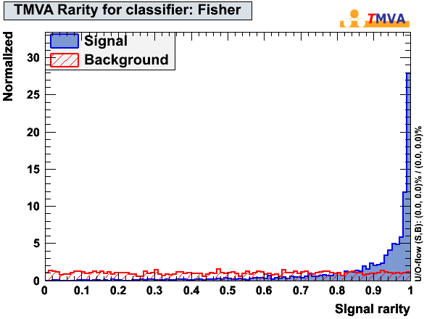
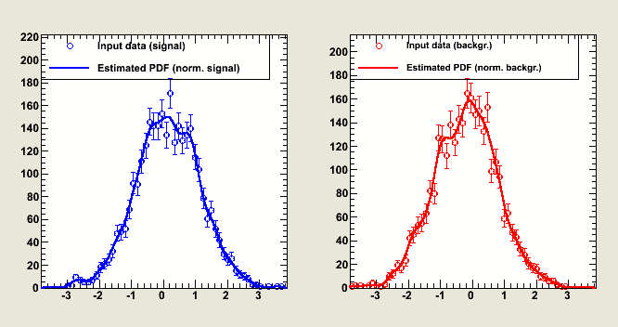
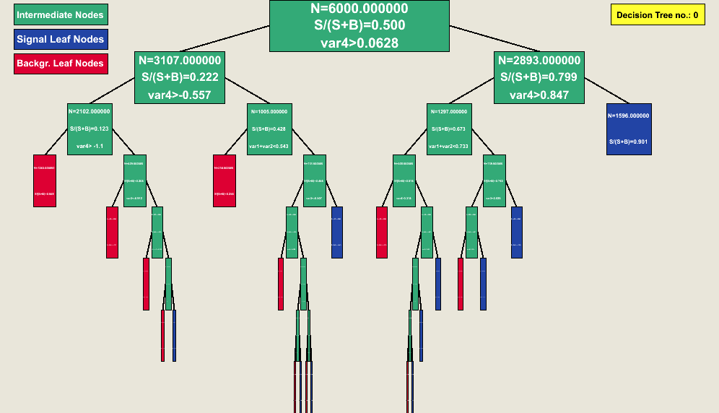
Multivariate Data Analysis with TMVA 4
TMVA core developer team: A. Höcker, P.Speckmayer, J.Stelzer, H.Voss; arXiv physics/0703039
minimization
The toolkit for multivariate analysis, TMVA, provides a large set of advanced multivariate analysis techniques for signal/background classification. In addition, TMVA now also contains regression analysis, all embedded in a framework capable of handling the pre-processing of the data and the evaluation of the output, thus allowing a simple and convenient use of multivariate techniques. The analysis techniques implemented in TMVA can be invoked easily and the direct comparison of their performance allows the user to choose the most appropriate for a particular data analysis.
Monte Carlo
Brute force method
Sample entire solution space, and chose solution providing minimum estimator
Good global minimum finder, but poor accuracy
TTree/
ASCII
Apply selection cuts
Possible independently for each class
preprocessing
Default solution in HEP: Minuit
Gradient-driven search, using variable metric, can use quadratic Newton-type solution
Poor global minimum finder, gets quickly stuck in presence of local minima
Minuit
var1
Transformations
Can be set for each Method independently
TMVA knows:
Normalisation
Decorrelation
Principal component analysis
Gaussianisation
Transformations can be chained
Transformations improve result in case of projective Likelihood and linear correlations of variables
May not improve classification in case of strong non-linear correlations
var2:=z[3]
original
decorrelation
Genetic Algorithm
Biology-inspired
“Genetic” representation of points in the parameter space
Uses mutation and “crossover”
Finds approximately global minima
varSin:=sin(x)+3*y
Define event weights
Can be defined globally, tree-wise and class-wise
Data input
Combination or function of available variables
Similar to ROOT’s TTree::Draw()
Principal components analysis
Like heating up metal and slowly cooling it down (“annealing”)
Atoms in metal move towards the state of lowest energy while for sudden cooling atoms tend to freeze in intermediate higher energy states → slow “cooling” of system to avoid “freezing” in local solution
Simulated Annealing
Gaussianization
classification
regression
Approximates the functional dependence of a target from (x₁,…x_{N})
{C₁,C₂}
R
R^{N}
R (R^{M})
Example: Target as a function of 2 variables
Output distribution for signal and background, each for training and testing + Kolmogorov-smirnov-test
x₁
y
x₂
y
x₃
… use their information
y₂
Scan over classifier output variable creates set of (ε_{sig},1-ε_{bkgd}) points
= ROC curves
cut on the classifier …
… condense the information
…
y₃
to separate into classes
… to one classifier output*
x_{N}
… to predict the value of one (or more) dependent variable(s): (targets)
Multiple input variables
*Cut classifier is an exception: Direct mapping from R^{N}→ {Signal,Background}
False positive (type 1 error) = ε_{backgr}:
classify background event as signal
→ loss of purity
evaluation
False negative (type 2 error) = 1-ε_{signal}:
fail to identify a signal event as such
→loss of efficiency
TMVA provides many evaluation macros producing plots and numbers which help the user to decide on the best classifier for an analysis
ROC (receiver operating characteristics) curve describes performance of a binary classifier by plotting the false positive vs. the true positive fraction
Working Point: Optimal cut on a classifier output (=optimal point on ROC curve) depends on the problem
Cross section measurement: maximum of S/√(S+B)
Signal Search: maximum of S/√(B)
Precision measurement: high purity
Trigger selection: high efficiency
1
“limit” in ROC curve
given by likelihood ratio
Correlation Matrices for the input variables
Inspect the neuronal network
Estimated value minus true value as a function of the true value
better classification
Parallel coordinates (give a feeling of the variable correlations)
1- ε_{backgr.}
random guessing
good classification
Look at the convergence of the neuronal network training
0
Show average quadratic deviation of true and estimated value
0
ε_{signal}
1
rarity
Display the estimated likelihood PDFs for signal and background
summary
Inspect the BDT
Classification
Regression
Criteria |  | Classifiers
 |  | Cuts | Likeli-hood | PDERS/ k-NN | H-Matrix | Fisher | MLP | BDT | RuleFit | SVM
Perfor-mance | no / linear correlations | 😐 | ☺ | ☺ | 😐 | ☺ | ☺ | 😐 | ☺ | ☺
 | nonlinear correlations | 😐 | ☹ | ☺ | ☹ | ☹ | ☺ | ☺ | 😐 | ☺
Speed | Training | ☹ | ☺ | ☺ | ☺ | ☺ | 😐 | ☹ | 😐 | ☹
 | Response | ☺ | ☺ | ☹/😐 | ☺ | ☺ | ☺ | 😐 | 😐 | 😐
Robust-ness | Overtraining | ☺ | 😐 | 😐 | ☺ | ☺ | ☹ | ☹ | 😐 | 😐
 | Weak input variables | ☺ | ☺ | ☹ | ☺ | ☺ | 😐 | 😐 | 😐 | 😐
Curse of dimensionality |  | ☹ | ☺ | ☹ | ☺ | ☺ | 😐 | ☺ | 😐 | 😐
Transparency |  | ☺ | ☺ | 😐 | ☺ | ☺ | ☹ | ☹ | ☹ | ☹
Conventional linear methods
Large number of MVA methods implemented
One common platform/interface for all MVA methods
Common data pre-processing capabilities
Common input and analysis framework (ROOT scripts)
Train and test all methods on same data sample and evaluate consistently
Method application w/ and w/o ROOT, through macros, C++ executables or python
☑ ☒
☑ ☑
☑ ☑
Cut based (still widely used since transparent)
Projective likelihood estimator (optimal if no correlations)
Linear Fisher Description (robust and fast)
Should only be used if non-linear correlations are absent
Common non-linear methods
☑ ☑
☑ ☑
☑ ☑
Neural Network (powerful, but challenging for strongly non-linear feature-space)
PDE: Range Search, kNN, Foam (multi-dim LHood → optimal classification)
Functional Description Analysis
Modern methods recent in HEP
☑ ☑
☑ ☑
☑ ☒
Boosted Decision Tree (brute force, not much tuning necessary)
Support Vector Machine (one global minimum, careful tuning necessary)
Learning via rule ensembles

